Slide 1
LEX

Slide 2
Introduction
Lex is a tool for generating a lexical analyzer for a compiler.
In Unix, it is available in a package called Flex.
It processes regular expressions and produces a table-driven lexical analyzer/scanner/lexer which is saved in a file called lex.yy.c. The scanner can also be output to any c file.
The scanner is then used to scan the input and generate the tokens.

Slide 4

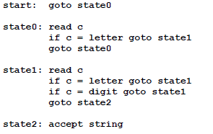
Lex and dfa
Exampe: For identifiers: letter(letter|digit)
Sample code for the above dfa

Slide 5
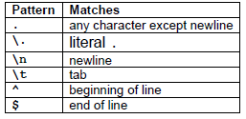
Special characters

Slide 6
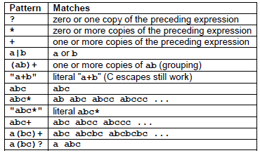
OPERATORS

Slide 7
More characters and their uses
Characters | Description
- | Used for range of charcaters. Eg. A-Z,a-z
[ ] | Matches any character from the class of characters within [ ]
[^] | Does not match any character from the class of characters within [ ]
| | Or operation
/ | Look ahead character. Eg: exp1/exp2 means pattern exp1 is matched only if it is followed by exp2.
( ) | Group series of expression to a new expression
{s} | Matches a string already defined for s.

Slide 8
Structure of lex program
%{
//Header files, variable declarations etc. This section //is optional.
%}
%option
%%
Regular expressions {action(s)}//
%%
Code by user.

Slide 9
Lex Variables
yyin: It is of type FILE*. This points to the current file being parsed by the lexer.
yyout: It is of type FILE*. This points to the location where the output of the lexer will be written. By default, both yyin and yyout point to standard input and output.
yytext: The text of the matched pattern is stored in this variable (char*).
yyleng: gives the length of the matched pattern.
yylineno :It provides current line number information

Slide 10
Directives(Similar to c keywords)
ECHO:- This directive copies the value of yytext to the scanner’s output.
BEGIN:- This directive followed by the name of the start symbol, places the scanner in the corresponding rules. Lex activates the rules using the directive BEGIN and a start condition.
REJECT:- It directs the scanner to proceed on to the "scanned best" rule which matched the input (or a prefix of the input)..

Slide 11
Some Lex functions
yylex(): Entry point for the generating the scanner.
int yywrap(): this function indicates the end of input. It returns 1 if there is no more input. If it returns 0 then yylex will assume that another file is opened for processing and hence continues.

Slide 12
References
“LEX & YACC TUTORIAL” by Tom Niemann.
“Compiler Design” by K Muneeswaran.
“Compilers: Principles, Techniques and Tools” by Alfred V Aho, Ravi Sethi and Jeffrey D. Ullman.

